Slide 1
CS2040 Lab06 B03 (Please set up your camera for Visualgo quiz) 05/10/2020

Slide 2
Inversion
Lab5 Problem 1

Slide 3
Summary
Given an array of ints, find the minimum number of swaps between adjacent elements to sort the array.

Slide 4
Approach 1
Perform bubble sort on the input array
Sum the number of swaps along the way

Slide 5
Complexity
Time complexity: O(n^2)
Space complexity: O(1) (in-place)

Slide 6
Can we do better?

Slide 7
Modified merge sort
See here for alternative approach

Slide 8
Zero
Lab5 Problem 2

Slide 9
Understand the Problem
Count subarrays that sum to 0
Continuous
Nonempty

Slide 10
Understand the Problem
Limits:
Elements ≤ 2.1bil – Can fit within int
Number of elements ≤ 10⁵
Ans may overflow int
≤ (10⁵ + 1)C2

Slide 11
Ideas
If number k appears n times in cum sum of an array, it means there are (n choose 2) subarrays whose sum is 0.
Sum from index i+1 to index j = cumsum[j] –cumsum[i]
E.g. : cum sum 1 6 3 8 6 4 6
We just need to count the frequency of numbers in cumsum and calculate.
Note that 0s in cumsum needs to be treated differently.

Slide 12
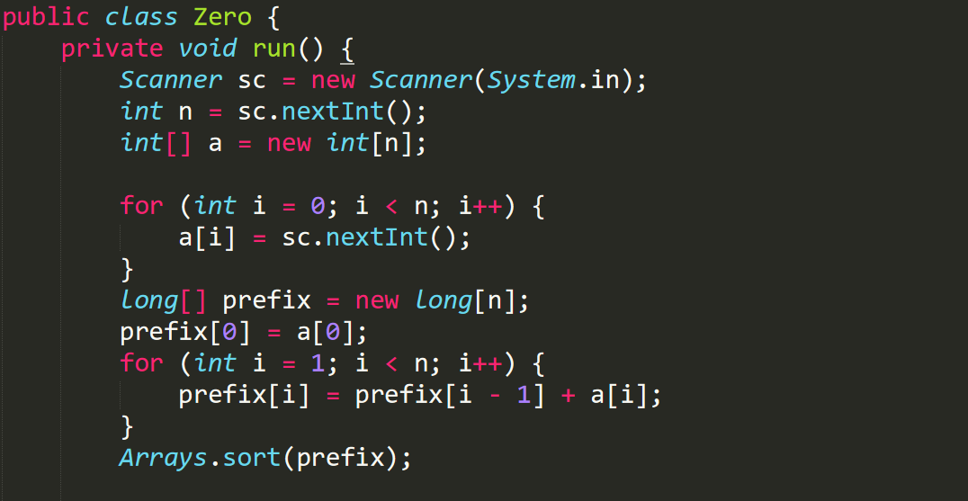
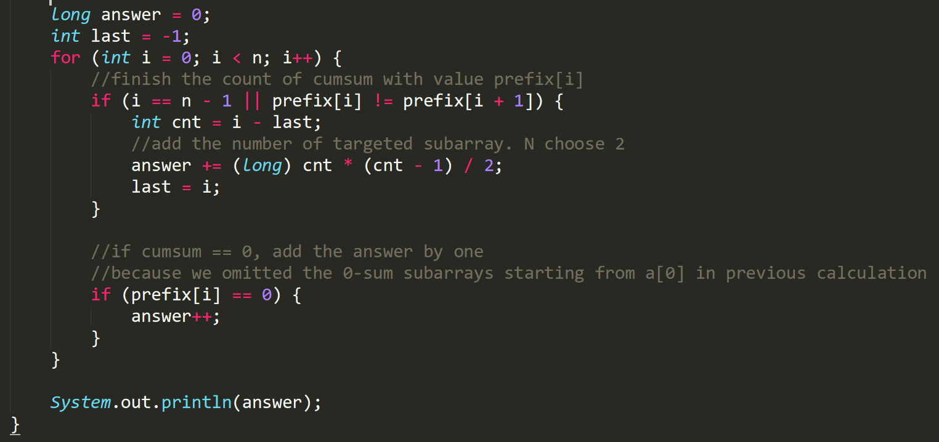
Solution

Slide 13
Visualgo quiz

Slide 14
Visualgo quiz
15 questions in 10 minutes
Make sure you record the right screen
Upload your recording to TG group after the quiz,
and name your video as NAME+MATRIC NUMBER+ SCORE
https://visualgo.net/training?diff=hard&n=15&tl=10&module=sorting

Slide 15
Nearest
Lab6 Problem 1

Slide 16
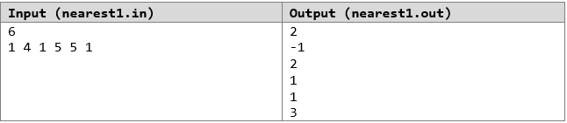
Question Statement
Given an array of integers of length n
For each element in the array, we want to find the distance of the nearest element (either to the left or to the right) that is equal to it

Slide 17
Naive Ideas
Idea 1
For each element:
Traverse left of element until you find equal element
Traverse right of element until you find equal element
Take minimum of two
Time complexity of both solutions are O(n² )
Idea 2
For each element from left to right of arr:
Traverse left of element until you find equal element
For each element from right to left of arr:
Traverse right of element until you find equal element
Take minimum of this and ans from first loop

Slide 18
Improvements
Idea 2(with help of hashMap)
For each element from left to right of arr:
Traverse right of element to find the nearest element to the left. (Traverse only once)
For each element from right to left of arr:
Traverse left of element to find the nearest element to the right.
Take minimum of this and ans from first loop
Expensive Traversals can be mitigated with help of HashMap

Slide 19
Improvement Visualization
First Loop from left to right of array (Find equal element left of current element)
1 | 4 | 1 | 5 | 5 | 1
map.containsKey(a[i]) → False
map.put(a[i], i) → (1, 0)
1 | 4 | 1 | 5 | 5 | 1
map.containsKey(a[i]) → True
Store currIndex - map.get(a[i]) → 2 – 0 (distance between nearest equal element in the left side)
map.put(a[i], i) → (1, 2)

Slide 20
Website
Lab6 Problem 2

Slide 21
Problem statement
Uncle Grandpa is currently running an E-commerce firm. Now he needs to analyze the market by looking at all the accesses to the website. There is a stream of logs that is received by his servers, each of form: IP country duration. Each IP is guaranteed to belong to no more than 1 country.
He will need to extract 3 types of information:
The maximum total duration of accessing time from any IP in a country.
Number of countries with at least one IP which has accessed the website
Number of distinct IP from a country

Slide 22
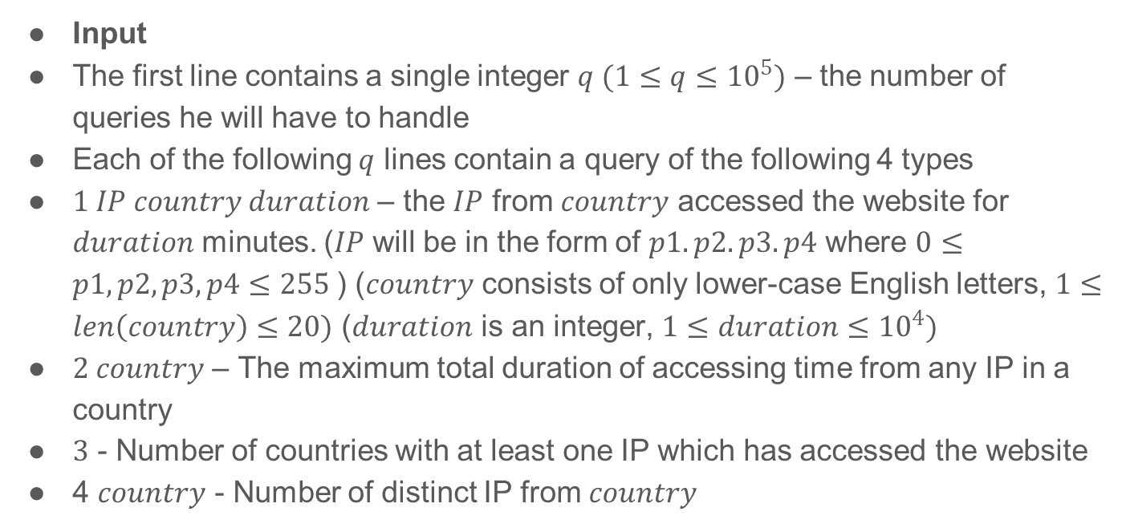
Problem statement
Input
The first line contains a single integer $q (1≤q≤{10}^{5})$ – the number of queries he will have to handle
Each of the following $q$ lines contain a query of the following 4 types
$1 IP country duration$ – the $IP$ from $country$ accessed the website for $duration$ minutes. ($IP$ will be in the form of $p1.p2.p3.p4$ where $0≤p1, p2, p3, p4≤255$) ($country$ consists of only lower-case English letters, $1≤len\left(country\right)≤20)$ ($duration$ is an integer, $1≤duration≤{10}^{4})$
$2 country$ – The maximum total duration of accessing time from any IP in a country
$3$ - Number of countries with at least one IP which has accessed the website
4 $country$ - Number of distinct IP from $country$

Slide 23
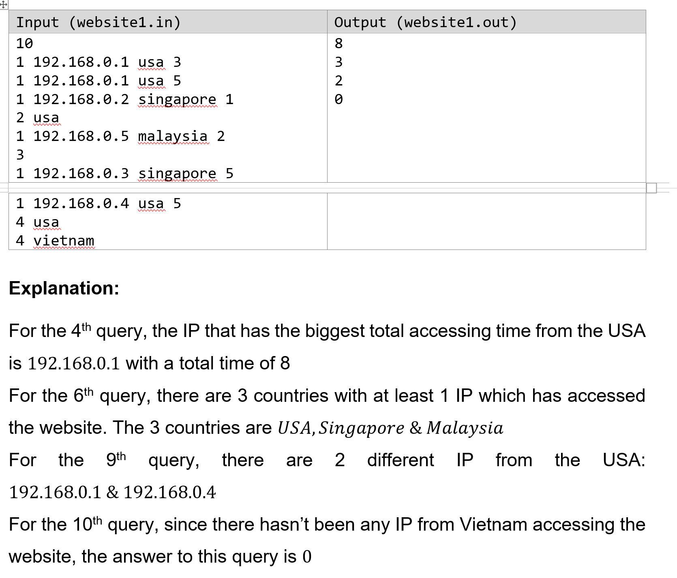
Example

Slide 24
Idea
Store information about the website and each country (number of distinct IPs, maximum access duration from any IP) in suitable data structures. It is a pre-process with time complexity O(n).
Upon query, we want to access the desired information from the respective data structure quickly in O(1) time.
Use HashMaps and HashSets!

Slide 25
Data Structures
HashMap<country, HashSet> uniqueIPs:
Store the unique IPs from each country in a HashSet.
HashSet<country> uniqueCountries:
Store the countries with at least one IP which has accessed the website.
HashMap<IP, Integer> IPMaxDuration:
Store the maximum access duration from each IP.
HashMap<country, Integer> CountryMaxDuration:
Store the maximum access duration from any IP in each country.

Slide 26
Hashset
Problem 3 (Demo)

Slide 27
Problem Statement
Given 2 arrays of size n, a and b. We need to answer queries in the form of “L R U V”. If the multiset of numbers a[L … R] is the same multiset as b[U … V], we print “Yes”, otherwise, we print “No”.
(A multiset allows for multiple instances for each of its elements. Two multiset are equal if for each value that appear in one set x times, it will also appear in the other set exactly x times and vice versa)

Slide 28
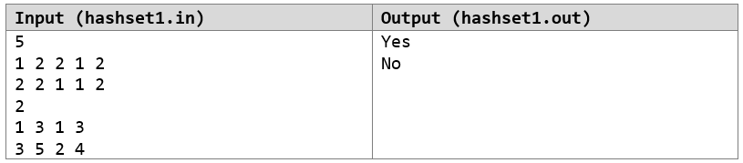
Example I/O
For the 1st query, the segment A[1…3] is [1,2,2] and the segment B[1…3] is [2,2,1]. We print “Yes” because these segments are the same multiset.
For the 2nd query, the segment A[3…5] is [2,1,2] and the segment B[2…4] is [2,1,1]. We print “No” because these segments are not the same multiset. Although they contain the same set of numbers, the individual frequencies of each element differs.

Slide 29
Possible Solution?
For each Query:
1 From L to R:
Count the frequencies of numbers in Array A
2 From U to V:
Count the frequencies of numbers in Array B
3 Check if all numbers in both segments have same frequency:
If yes print “Yes”, else, print “No”
The above time complexity would be O(q*n). We can’t decrease the number of queries to answer, but we can definitely do a better job answering them with some preprocessing.

Slide 30
Hint
One way we can compare 2 sets of numbers is to compare their hash values. The question is then, how do we implement a hashing method to hash sets of numbers?
One of the possible way to hash a set of numbers is to sum all the elements. For example, the two sets [1,4,1] and [4,1,1] are equal to each other because their sums are the same! Yet the two sets [3,3] and [6,0], despite having the same sum, are also not equal to each other.
Another possibility is to perhaps sum their squares. The sets [1,4,1] and [4,1,1] would still be equal. But now, [3,3] and [6,0] would be correctly determined as not equal sets (18 != 36). But then there’s [2, 2, 3], [4, 1, 0], they are not equal but have equal sum of squares.
How complex should our hashing algorithms be to avoid “wrong” answers?

Slide 31
Cumulative Sum Array
After figuring out what hashing function to use, we still need a way to obtain “range-information” from our arrays. We can again create the cumulative sum arrays in O(n) time. Now we can answer each query in O(1) time by comparing the ranges of our 2 arrays.
The trick is to apply our hashing algorithms before we add the number up.
long[ ] squaredSumArray;
squaredSumArray[0] = a[0] * a[0];
For (i = 1; i < n; i++):
squaredSumArray[i] = a[i] * a[i] + squaredSumArray[i - 1] ;
Note that we will have 2 of such arrays, 1 for array A and another for array B

Slide 32
Cumulative Sum Array
We don’t have to limit ourselves to only 1 of such array. We can have constant multiple number of cumulative sum arrays where we apply different hashing algorithms to each. We then compare all the ranges to their respective counterparts to determine if the ranges are equal.
long[ ] sumArray;
long[ ] squareSumArray;
long[ ] anotherHashingMethod;
long[ ] yetAnotherHashingMethod;
long[ ] youGuessedIt;
The more “criteria” our ranges have to “pass”, the more accurate our algorithm is.
Note that we will have 2 of each array, 1 for array A and another for array B

Slide 33
Comparing Ranges
Given a query L, R, U, V. we can compare our cumulative sum arrays (CSA) by the following. Assuming we end up with 3 seperate CSAs to check for equivalence.
long[ ] a_csa1, b_csa1;
long[ ] a_csa2, b_csa2;
long[ ] a_csa3, b_csa3;
If ( (a_csa1[R] - a_csa1[L - 1]) == (b_csa1[V] - b_csa1[U - 1]) &&
(a_csa2[R] - a_csa2[L - 1]) == (b_csa2[V] - b_csa2[U - 1]) &&
(a_csa3[R] - a_csa3[L - 1]) == (b_csa3[V] - b_csa3[U - 1]) )
print(“Yes”);
else print(“No”)
We -1 because we want to include index U in the range. Of course we need to account for if U is 0 which has been omitted here.

Slide 34
Experiment
Now our algorithm runs in O(q+n) time.
Go try out different hashings, find out what works and what doesn’t.
Have fun!
Demo

